Slide 1
LEARNING PYTHON
20220928
4110E230

Slide 2
OBJECTIVE
Learning Pythons
Input and Output
Data Types
Operators

Slide 3
Content
What is Python?
Python Jobs
Why to Learn Python
Python Online Interpreter
One
Two
Google Colab
Python Codes

Slide 4
What is Python
a high-level general-purpose programming language.
Python is dynamically-typed and garbage-collected. It supports multiple programming paradigms, including structured, object-oriented and functional programming

Slide 5
Python Jobs
Python is not only one of the most popular programming languages across the globe, but it is one that offers the most promising career opportunities as well. This demand for Python developers is increasing every year. There is a reason why this high-level programming language is so popular.
There are big Companies that uses python programming language such as
Facebook
YouTube
Google
Netflix

Slide 6
Why to Learn python
Python is a very popular programming language today and often needs an introduction. It is widely used in various business sectors, such as programming, web development, machine learning, and data science.
Python is a general-purpose, versatile and popular programming language. It’s great as a first language because it is concise and easy to read, and it is also a good language to have in any programmer’s stack as it can be used for everything from web development to software development and scientific applications.

Slide 7
Why to Learn python
5 Top Reasons to Learn Python
Python is the Easiest Programming Language to Learn
Python is the Most Versatile Coding Language
Learning Python will Improve Your Job Prospects
You can Earn a Competitive Salary Working as a Python Developer
Become Part of a Supportive Python Community

Slide 8
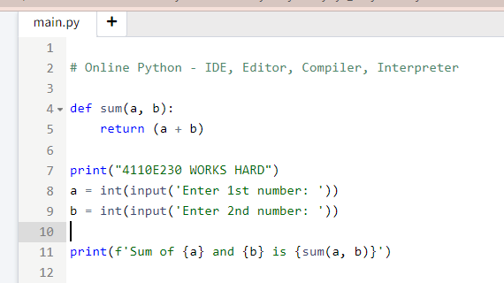
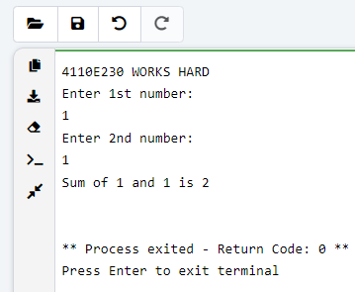
Python Online Interpreter: 1

Slide 9
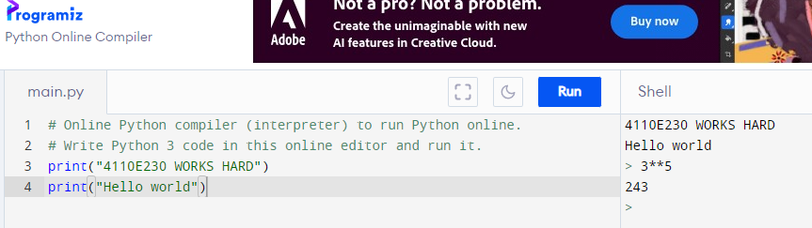
Python Online Interpreter: 2
INTERACTIVE

Slide 10
INPUT AND OUTPUT
20220928

Slide 11
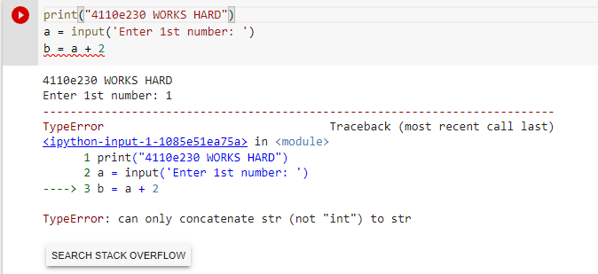
QUESTION:
DATA TYPE

Slide 12
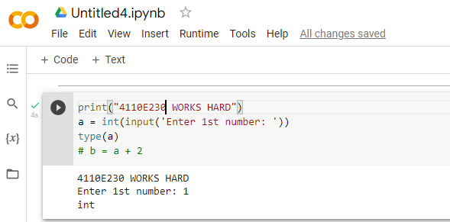
WAY: 1

Slide 13
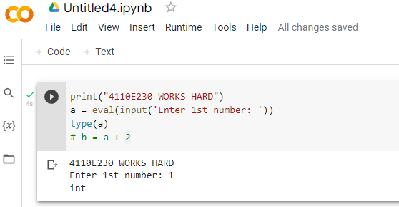
WAY: 2

Slide 14
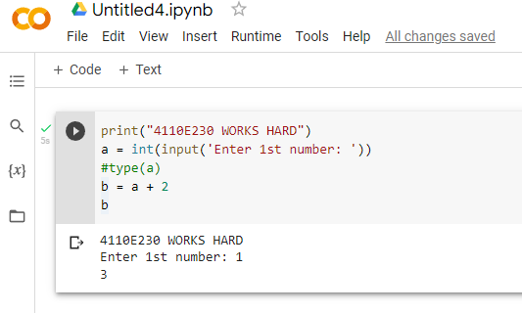
ANSWER: 1

Slide 15
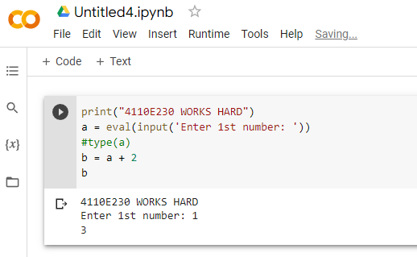
ANSWER: 2

Slide 16
PYTHON DATA TYPES
20220928

Slide 17
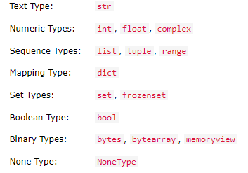
DATA TYPES
In programming, data type is an important concept.
Variables can store data of different types, and different types can do different things.
Python has the following data types built-in by default, in these categories:

Slide 18
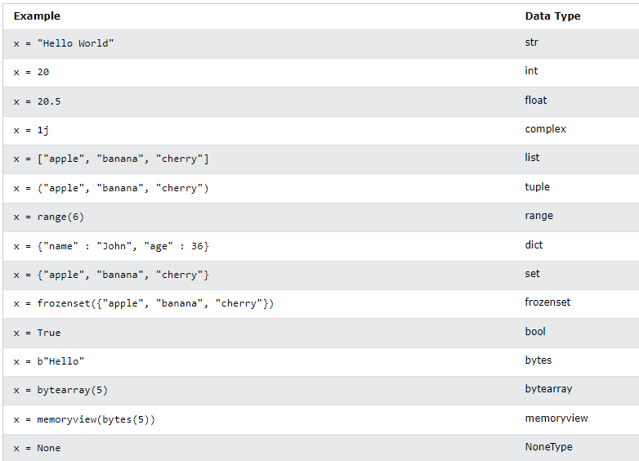
SETTING THE SPECIFIC DATA TYPE

Slide 19
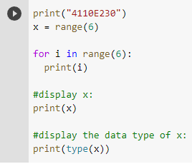
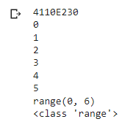
PYTHON DATA

Slide 20
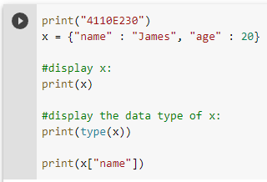

DICT: KEY VALUE PAIR

Slide 21
PYTHON OPERATORS
20220928

Slide 22
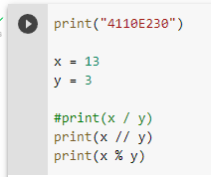
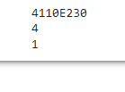
PYTHON ARITHMETIC OPERATORS

Slide 23
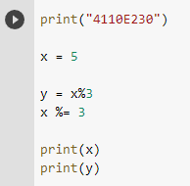

PYTHON ASSIGNMENT OPERATORS

Slide 24
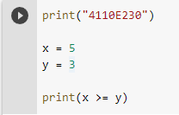

PYTHON COMPARISON OPERATORS

Slide 25
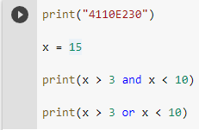

PYTHON LOGICAL OPERATORS

Slide 26
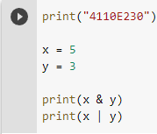

PYTHON BITEWISE OPERATORS

Slide 27

THANK YOU
CHINESE NAME: 彭哈帕
STUDENT ID: 4110E230
ENGLISH NAME: James Ryan H. Pregon
NICKNAME: Kaori
Email: jamesryanpregon@gmail.com
GITHU: https://github.com/PengHaPa/cs2022.git

